Slide 1
Hands On: Draft Automation
Greg Chasteen, Technical Account Manager, Siemens PLM Software

Slide 2
Agenda
Use the application already developed by you for “Hands On: Visual Studio 2012”.
Add a new button and under the “Button_Click” event write a program which will do following steps
Declare Variables
Get Sold Edge application object
Function to Get Training Folder
Open Draft file
Get DrawingViews Collection
Iterate through each Drawingview
Create New layer for each DrawingView
Move each DrawingView to new Layer
Export PartsList
More…..

Slide 3
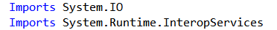
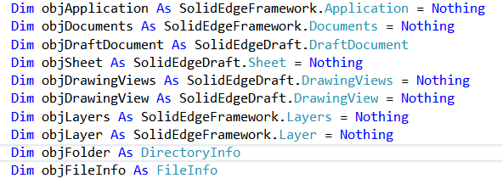
Declare the variables
Double click the Button that you have created just now and write following code.

Slide 4
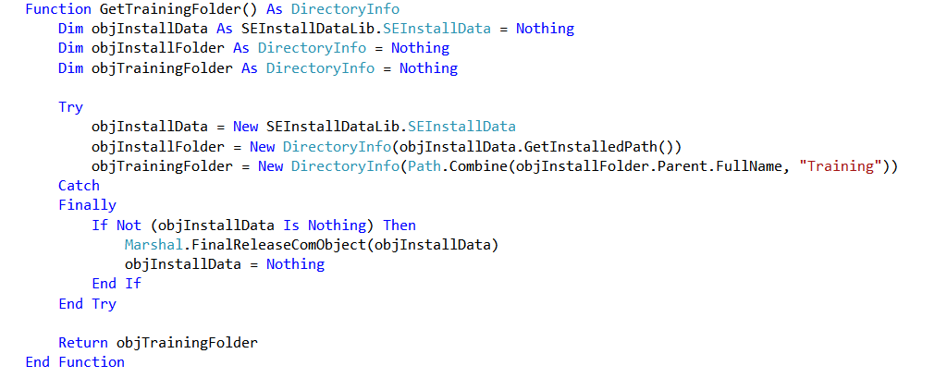
Write a function to search “Training” folder
Solid Edge installation creates a Training folder on your machine. Installation folder location could be different on everybody’s machine. We will write a function to search for Training folder on your machine.

Slide 5
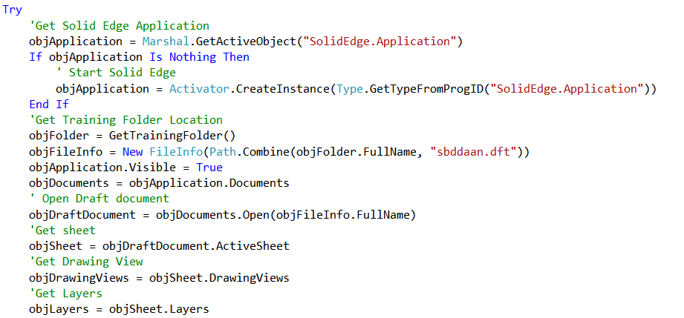
Get Solid Edge Application

Slide 6
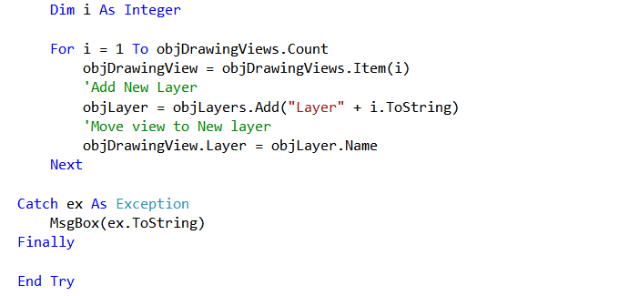
Create Layers
You can Iterate through each DrawingView to create new Layer and Move objects to these newly created layers.
To execute your program press F5.

Slide 7
Export Solid Edge Parts List
We have prepared a sample code to extract Parts List from draft file.
BeginnerTrack\_05-Hands-On Draft Automation\Export SE Partslist

Slide 8
Contact
Greg Chasteen
Technical Account Manager
Siemens PLM Software
675 Discovery Drive, Suite 100
Huntsville, Al 35806
Office: (256) 705-2621
Cell:(256) 479-9055
E-mail:
chasteen.gregory@siemens.com

